Slide 1
Deadlock Detection
Deadlock Detection Algorithm helps decide if in scenario of multi instance resources for various processes are in deadlock or not.
In cases of single resource instance we can create wait-for graph to check deadlock state. But, this we can’t do for multi instance resources system.
Allow system to enter deadlock state
Detection algorithm
Recovery scheme

Slide 2
Single Instance of Each Resource Type
Maintain wait-for graph » Nodes are processes » Pi → Pj if Pi is waiting for Pj
Periodically invoke an algorithm that searches for a cycle in the graph. If there is a cycle, there exists a deadlock
An algorithm to detect a cycle in a graph requires an order of n2 operations, where n is the number of vertices in the graph

Slide 3
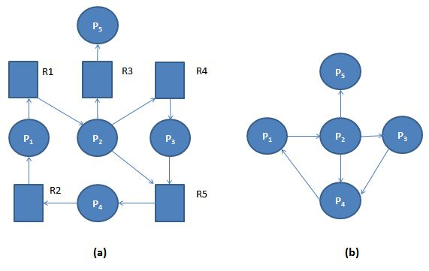
Example: (a). 'Resource-Allocation Graph' and Corresponding (b). 'Wait-for Graph'

Slide 4
Several Instances of a Resource Type
Available: A vector of length m indicates the number of available resources of each type.
Allocation: An n x m matrix defines the number of resources of each type currently allocated to each process.
Request: An n x m matrix indicates the current request of each process. If Request [i][j] = k, then process Pi is requesting k more instances of resource type Rj.

Slide 5
1. Let Work and Finish be vectors of length m and n, respectively Initialize:
(a) Work = Available
(b) For i = 1,2, …, n, if Allocation ≠ 0, then Finish[i] = false; otherwise, Finish[i] = true
2. Find an index i such that both:
(a) Finish[i] == false
(b) Request ≤ Work If no such i exists, go to step 4
3. Work = Work + Allocation, Finish[i] = true go to step 2
4. If Finish[i] == false, for some i, 1 ≤ i ≤ n, then the system is in deadlock state.
Moreover, if Finish[i] == false, then Pi is deadlocked

Slide 6
Five processes P0 through P4; three resource types A (7 instances), B (2 instances), and C (6 instances)
Snapshot at time T0:
Allocation | Request | Available
Process | A B C | A B C | A B C
P0 | 0 1 0 | 0 0 0 | 0 0 0
P1 | 2 0 0 | 2 0 2
P2 | 3 0 3 | 0 0 0
P3 | 2 1 1 | 1 0 0
P4 | 0 0 2 | 0 0 2

Slide 7
Sequence <P0, P2, P3, P1, P4> will result in Finish[i] = true for all I
P2 requests an additional instance of type C
Request
Process | A B C
P1 | 2 0 0
P2 | 3 0 3
P3 | 2 1 1
P4 | 0 0 2
State of system?
Can reclaim resources held by process P0, but insufficient resources to fulfill other processes; requests
Deadlock exists, consisting of processes P1, P2, P3, and P4

Slide 8
Detection-Algorithm Usage
When, and how often, to invoke depends on:
How often a deadlock is likely to occur?
How many processes will need to be rolled back? one for each disjoint cycle
If detection algorithm is invoked arbitrarily, there may be many cycles in the resource graph and so we would not be able to tell which of the many deadlocked processes “caused” the deadlock.

Slide 9
4) Detection and Recovery
When the system is in deadlock then one method is to inform the operates and then operator deal with deadlock manually and the second method is system will automatically recover from deadlock. There are two ways to recover from deadlock.
Process termination
Deadlock can be eliminated by aborting a process. Abort all deadlock process. Abort is processed at a time until the deadlock cycle is eliminated. This can help to recover the system from file deadlock.
Resources preemption
To eliminate deadlock using resources preemption, we prompt the same resources pass processes and give these resources to another process until the deadlock cycle is broken. Here a process is partially rollback until the last checkpoint or and hence detection algorithm is executed.

Slide 10
When a detection algorithm determines that a deadlock exists, several alternatives are available.
One possibility is to inform the operator that a deadlock has occurred and to let the operator deal with the deadlock manually.
Another possibility is to let the system recover from the deadlock automatically.
There are two options for breaking a deadlock.
One is simply to abort one or more processes to break the circular wait.
The other is to preempt some resources from one or more of the deadlocked processes.

Slide 11
Abort one process at a time until the deadlock cycle is eliminated.
This method incurs considerable overhead, since, after each process is aborted, a deadlock-detection algorithm must be invoked to determine whether any processes are still deadlocked. Aborting a process may not be easy. If the process was in the midst of updating a file, terminating it will leave that file in an incorrect state.

Slide 12
2) Resource Preemption
To eliminate deadlocks using resource preemption, we successively preempt some resources from processes and give these resources to other processes until the deadlock cycle is broken. If preemption is required to deal with deadlocks, then three issues need to be addressed:
1) Selecting a victim.
Which resources and which processes are to be preempted? As in process termination, we must determine the order of preemption to minimize cost. Cost factors may include such parameters as the number of resources a deadlocked process is holding and the amount of time the process has thus far consumed during its execution.
2) Rollback.
If we preempt a resource from a process, what should be done with that process? Clearly, it cannot continue with its normal execution; it is missing some needed resource. We must roll back the process to some safe state and restart it from that state.

Slide 13
Since, in general, it is difficult to determine what a safe state is, the simplest solution is a total rollback:
Abort the process and then restart it. Although it is more effective to roll back the process only as far as necessary to break the deadlock, this method requires the system to keep more information about the state of all running processes.
In which order should we choose to abort?
Priority of the process
How long process has computed, and how much longer to completion
Resources the process has used
Resources process needs to complete
How many processes will need to be terminated
Is process interactive or batch?

Slide 14
Q1) The wait-for graph is a deadlock detection algorithm that is applicable when
a)All resources have a single instance b)All resources have multiple instances c)All resources have a single 7 multiple instances
d) All of the mentioned

Slide 15
Q2) What is the disadvantage of invoking the detection algorithm for every request?
a) Overhead of the detection algorithm due to consumption of memory b) Excessive time consumed in the request to be allocated memory c) Considerable overhead in computation time d) All of the mentioned

Slide 16
Q3) Each request requires that the system consider the _____________ to decide whether the current request can be satisfied or must wait to avoid a future possible deadlock.
a)Resources currently available
b) Processes that have previously been in the system
c) Resources currently allocated to each process d) Future requests and releases of each process

